Slide 1
Welcome
Name | ID
Tridib Sarkar | 22-46444-1
Mahmudus Sami Maahi | 22-46446-1
Robiul Islam Roman | 22-46490-1
Md. Mehedi Hasan Polash | 22-46566-1

Slide 2
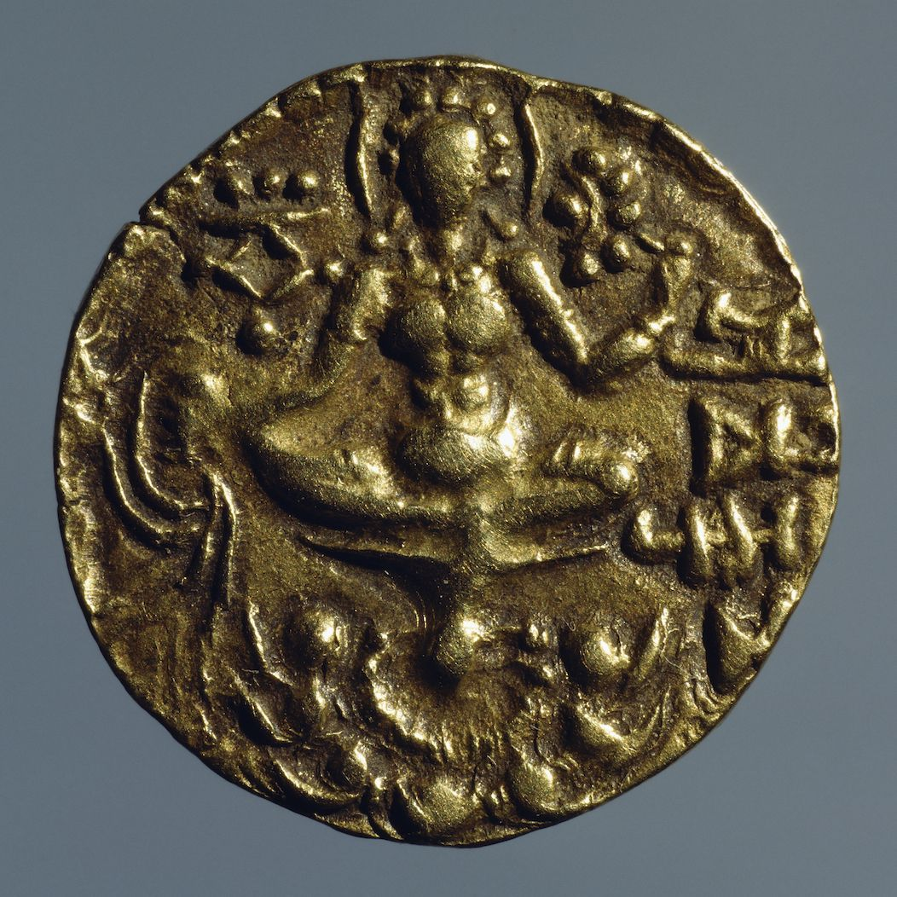
Gupta Dynasty

Slide 3
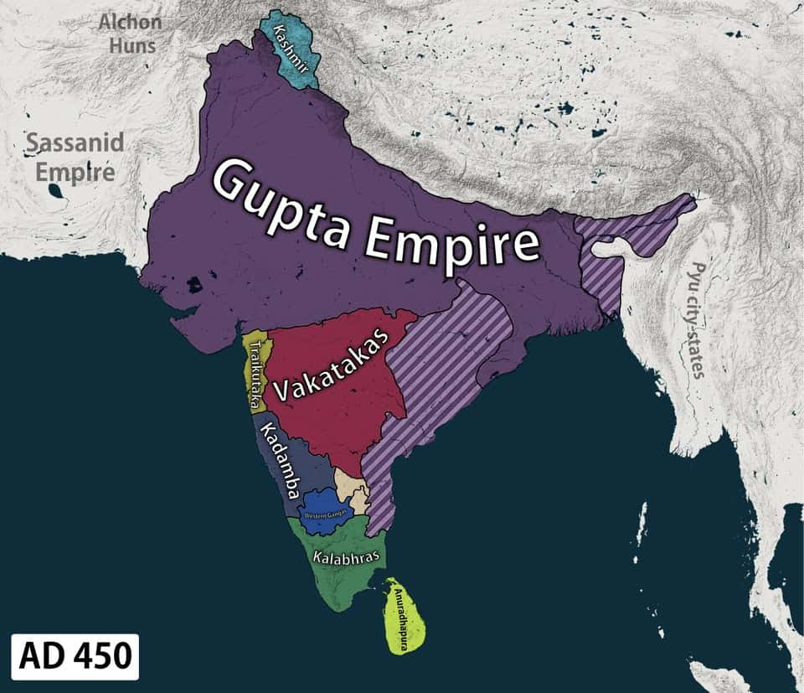
Evolution of Gupta Dynasty
Various parts of India were ruled by numerous dynasties for the next 1,500 years during the Classical period, with the Gupta Empire standing out.
4th to 5th Century AD
Controlled a large part of Bengal for nearly two centuries.
The period of the Imperial Guptas is generally considered as the golden age of Indian history for its trade and commerce, in which Bengal had her due share.

Slide 4
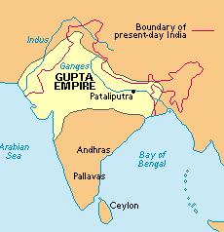
In Gupta Empire, the king was directed in his administration by a community and group consisting of a chief minister and a Senapati. There were various names of Empire "Rajya", Rashtra", "Desha", "Mandala", "Prithvi" and "Avani". The Empire was divided into provinces called as Bhukti, Bhoga and pradesha.
The Administration of Gupta

Slide 5
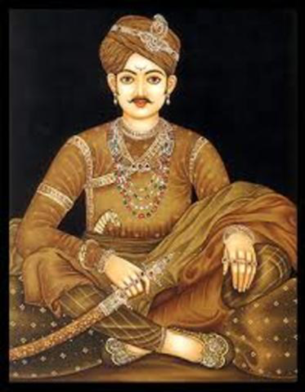
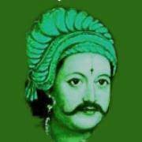
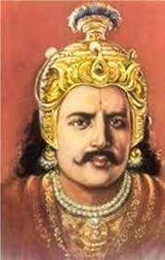
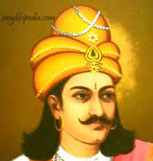
Gupta Empire
Gupta rulers were liberal patrons of Hinduism. The ruling dynasty of the empire was founded by the king Sri Gupta; the most notable rulers of the dynasty were
Chandragupta I
Samudra Gupta
Chandragupta II
Skanda Gupta

Slide 6
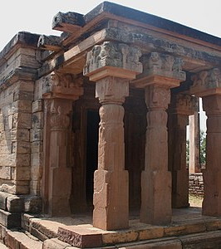
Economy
The discovery of large number of Gupta coins and imitation Gupta coins in Bengal prove the economic prosperity of the region under the Guptas. The Gupta Empire’s mainstay was agriculture.

Slide 7
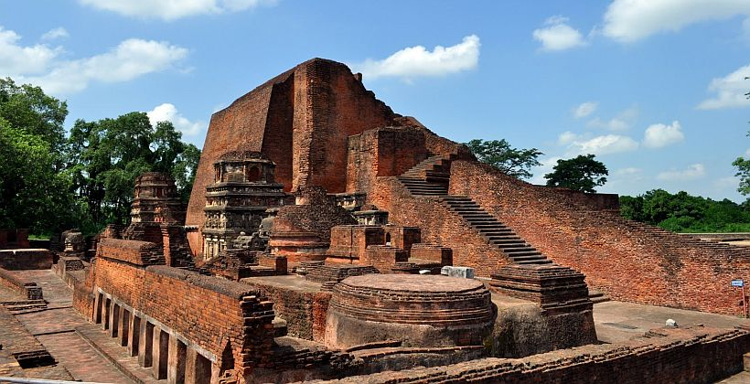
Achievement of Gupta dynasty
Among the products traditionally thought to be from the Gupta era were the
Decimal system of notation
The great Sanskrit epics and Hindu art
Along with contributions to the sciences of astronomy
Mathematics and metallurgy.

Slide 8
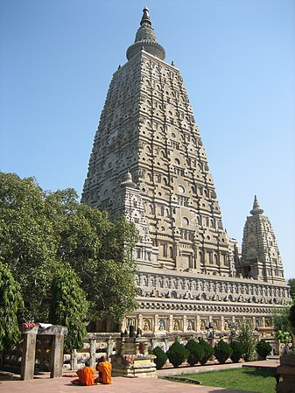
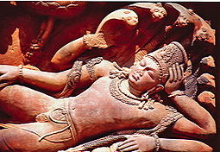
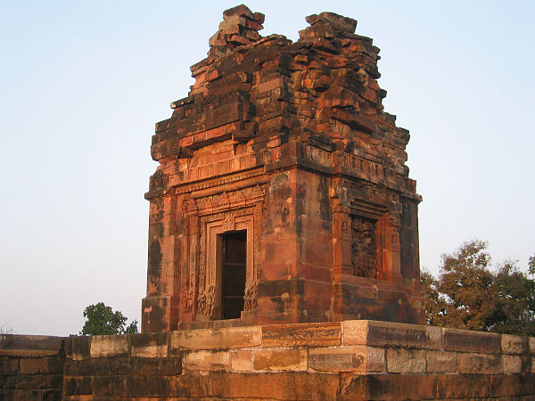

Art and architecture
The Gupta period is generally regarded as a classic peak of North Indian art for all the major religious groups like Hindu, Buddhist, Jain majority. The most famous remaining monuments in a broadly Gupta style, the caves at Ajanta, Elephanta, and Ellora. The Hindu Udayagiri Caves actually record connections with the dynasty and its ministers and the Dashavatra Temple at Deogarh is a major temple, one of the earliest to survive, with important sculpture.

Slide 9
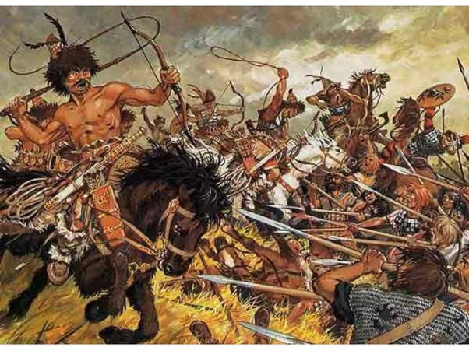
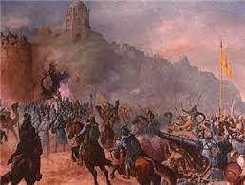
Decline of the Gupta Empire
The Gupta Empire flourished under Chandragupta II, but began to falter under his son, Kumaragupta, and grandson, Skandagupta.
The Huna People, also known as Huns, invaded Gupta territory and caused significant damage to the empire.
The Gupta Empire ended in 550 CE, when it disintegrated into regional kingdoms after a series of weak rulers and invasions from the east, west, and north.

Slide 10
Conclusion
The Gupta period is often considered to be the pinnacle of North Indian art. Despite the fact that painting was evidently widespread, the majority of the surviving works are religious sculptures. In Hindu art, the iconic carved stone deity, as well as the Buddha figure and Jain Tirthankara figures, appeared during this time period, the latter often on a grand scale. Mathura and Gandhara were the two major sculpture centres, the latter being the epicentre of Greco-Buddhist art. Both sculptures were exported to other parts of northern India.

Slide 11
Thank You

